Slide 1

SIH 2023
Ministry/Organization Name:
Ministry Of Law and Justice
Problem Statement Title:
Digital Assistant for Legal Awareness and Designing a KYR framework in India
Problem Statement Number:
1283
Theme Name:
Smart Education
Institute Code:
C33773
Institute Name:
Sardar Patel Institute Of Technology
Team Name:
Habeas Codus
Team Leader Name:
Saad Surve

Slide 2

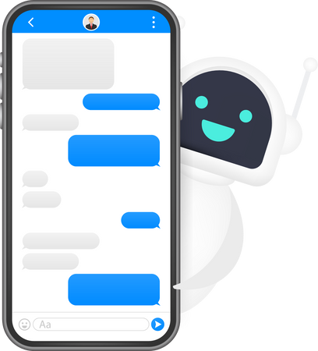




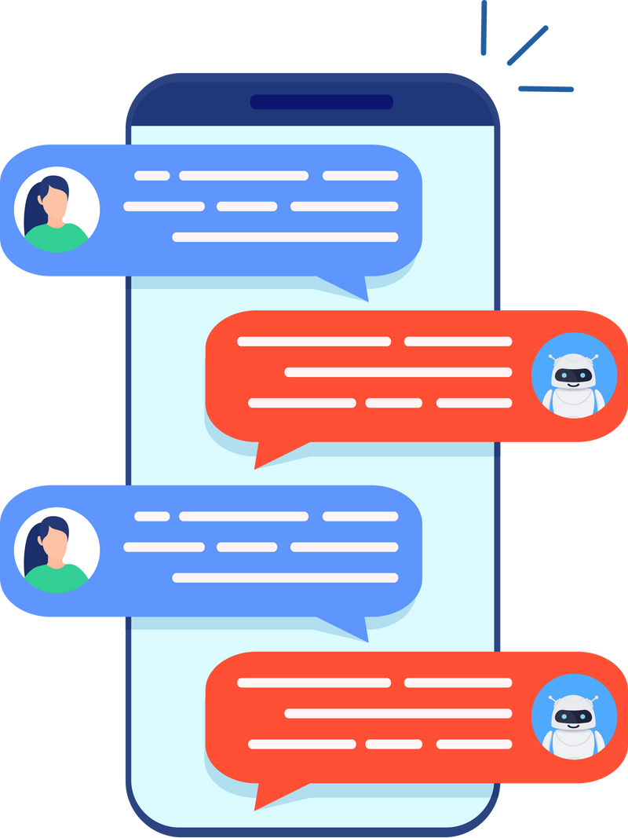

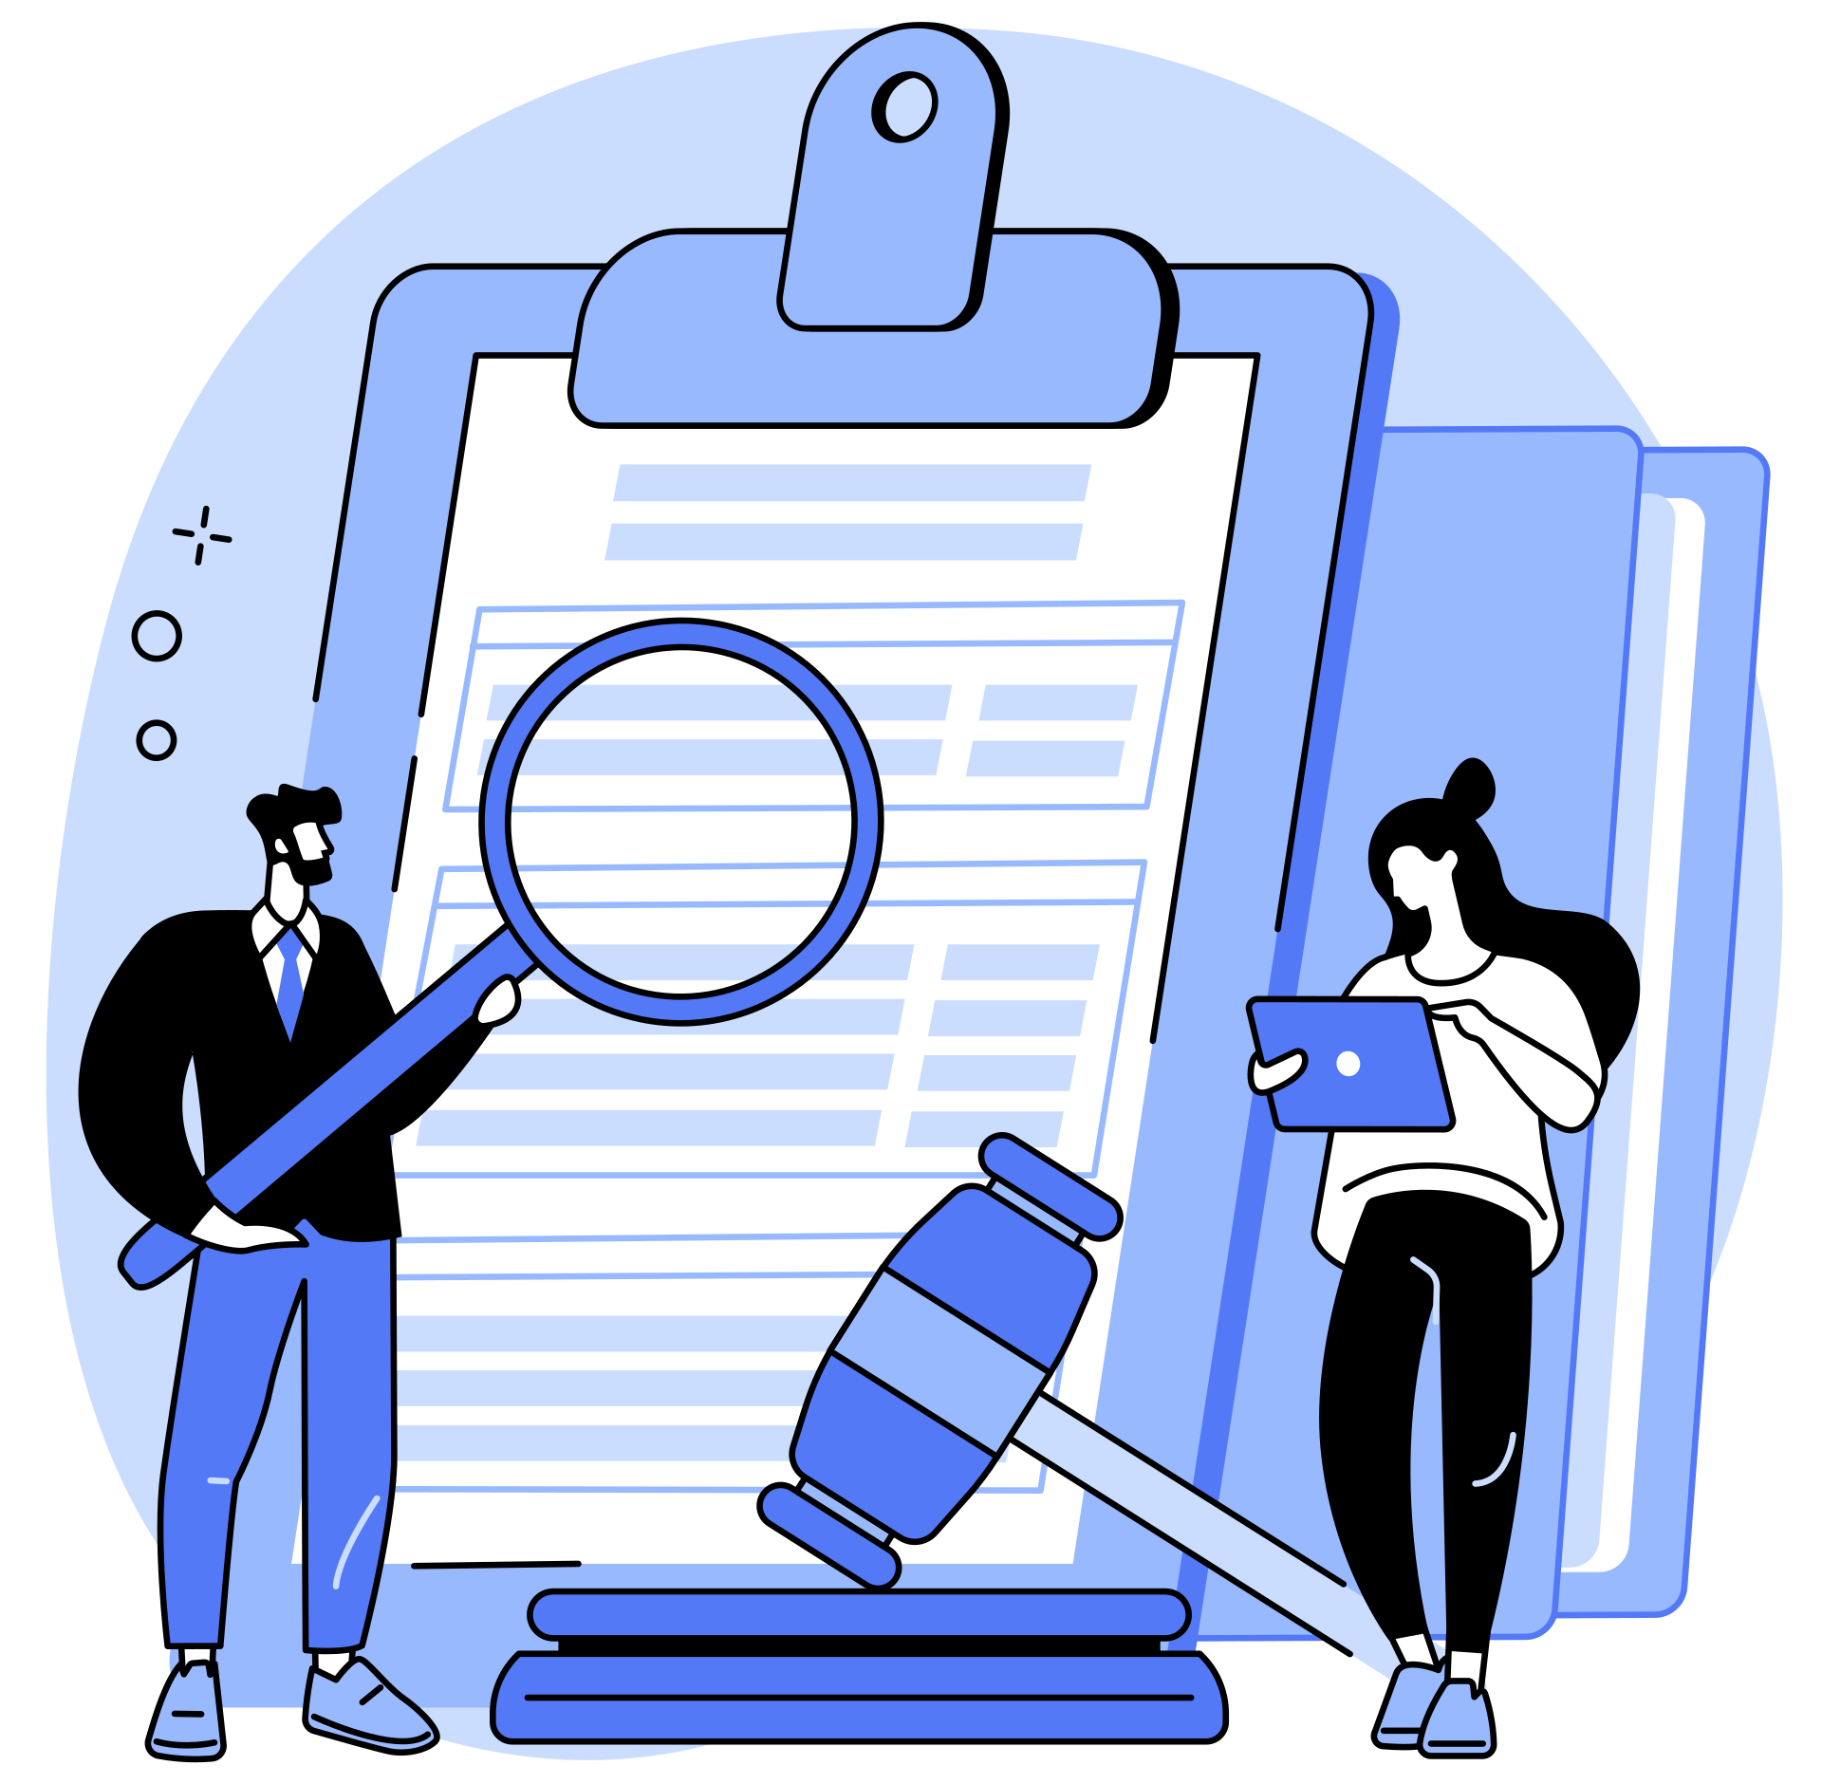

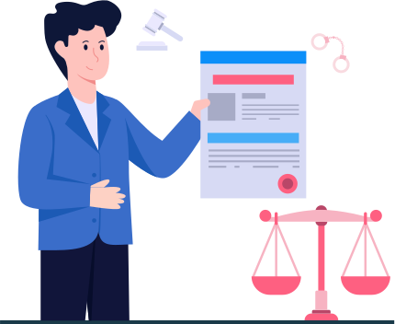


Nyaydoot (न्यायदूत)
Know-Your-Rights
Framework
Digital Assistant
Our solution Nyaydoot, integrates AI chatbot, legal aid collaborations, real-time legal news, a user-friendly law search, a comprehensive legal directory, and document creation links, empowering individuals with legal knowledge, enhancing accessibility, and promoting awareness of citizen rights.
Identify, simplify, and categorize laws
Chatbot with multilingual and voice support
Website with accessibility features, WhatsApp integration and Telegram integration.
Guide users through a series of questions to help them understand their rights and options in specific legal situations.
Collaboration with legal aid providers
subheading
Multilingual Support by providing availability in regional languages
Legal aid providers can extend assistance to individuals who require legal support.
Scenario-based advice and Immediate Access to information.
Links to resources for most frequently used legal documents
Keep the platform up to date with the latest legal changes, case law, and resources
Boost legal awareness with articles and videos from courtroom pros.
Designed for expansion and accessibility at large scale
Creating a comprehensive database of relevant laws and regulations in India

Slide 3


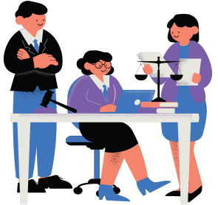














Multilingual
Web Design
(to overcome
language barrier)
User Interaction Diagram
Legal
Directory
(Contacts of
Registered Legal Aid Providers)
TECHNOLOGY STACK WITH COST ANALYSIS
Scenario
Based
Advice
(Immediate access
to information)
Deployment
ReactJS - Frontend
NodeJS - Backend
MongoDB
Free
$ 24.95
(per month)
Digital
Assistant
Community Connect
(Posts by Lawyers for Legal awareness)
Users
Legal Aid
Providers
Telegram Support
&
APIs
OAuth 2.0
Bing News Search
Free
Free
WhatsApp
Support
(utilize already
existing
infrastructure)
Web App
(upto 50,000 users)
Chatbot
BotPress
Free
Legal
Resources
(One-stop access to all the legal websites)
Legal
News
(Using Bing News
Search API)
Legal
Documents
(links for
issuing documents)
Frequently
Asked
Questions
(with platform
limits)
Dependencies
Data Quality: Accurate and up-to-date legal information sources.
Accessibility Compliance: Conformance with accessibility standards (e.g., WCAG).

Slide 4
Team Member Details
Team Leader Name: Saad Surve
Branch: B.Tech
Stream: CSE
Year: III
Team Member Name: Ankit Mishra
Branch: B.Tech
Stream: CSE
Year: III
Team Member Name: Vyoum Khare
Branch: B.Tech
Stream: EXTC
Year: IV
Team Member Name: Yusuf Sodawala
Branch: B.Tech
Stream: CSE
Year: III
Team Member Name: Jayraj Menon
Branch: B.Tech
Stream: CSE
Year: III
Team Member Name: Neha Gode
Branch: B.Tech
Stream: CSE
Year: III
Team Mentor Name: Dr. Nataasha Raul
Category:Academic
Expertise: Machine Learning
Domain Experience : 17 Years
Team Mentor Name: Dr. Kailas Devadkar
Category: Academic
Expertise: Cloud Computing, Databases
Domain Experience : 25 Years

